Slide 1







INPATIENT AVAILMENT PROCEDURE
STEP 1
STEP 2
STEP 3
STEP 4
Secure an admitting order from a Maxicare-accredited doctor or specialist
Acquire a Letter of Eligibility (LOE) at the admitting section by presenting your Maxicare card and valid ID
Avail inpatient services, treatment, or both
File PhilHealth upon discharge and settle non-coverable charges

Slide 2
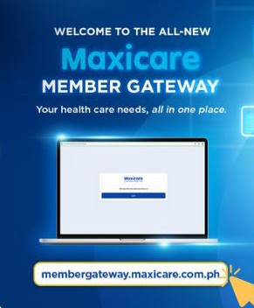

Claims and Reimbursement
All claims must be submitted to New! Member Gateway within 30 days from date of discharge from the hospital. The following are the required documents for reimbursement:
Sales Invoice of all hospital bills & professional fee of the Doctor;
Charge slips (with itemized breakdown of charges);
Clinical abstract, admitting history and medical certiﬁcate;
Histopath/Surgical Report (if surgical operation was done);
Police Report in case of accident and medico legal cases:
The processing time for reimbursements is ﬁfteen
(15) WORKING DAYS, starting from the submission date of COMPLETE DOCUMENTS TO CREDITING.
33

Slide 3








DENTAL CARE
DENTAL HUB NETWORK
with access to accredited dental facilities nationwide
Member sets an appointment by calling
(02) 8582-1900*
* Members can also directly call their preferred dental clinics for scheduling.

Slide 4



Customer Care Hotline
(+632) 7798 7777
(+632) 8582 1900
Customer Care Email
customercare@maxicare.com.ph
Product Inquiry Hotline
(+632) 7798 7770
Teleconsult Hotline
(+632) 8582 1980
(+632) 7798 7798
24/7 SMS Inquiry
(+63) 922 110 1733

Slide 5


